Slide 1
Generative Models
AI ToolKit
Fall Semester, 2023
Notes:
How can summarize matrices, how matrices can be decomposed.

Slide 2
Generative Adversarial Networks (GANs)
Train a generator that can generate a data sample from random vector.
Learn how the multi-dimensional random vector corresponds to data points in the target domain.
But how can we do this when there is no labeled data?
Random Vector
Input
Generated Sample
Generator

Slide 3
GAN: a two-player game
Add a discriminator which discriminates whether the input data sample is real or fake.
Random Vector
Input
Return 0 if given input is fake
Generator
Fake Data
Discriminator
Return 1 if given input is real
Real Data

Slide 4
GAN: a two-player game
Add a discriminator which discriminates whether the input data sample is real or fake.
Fool the Discriminator,
so that 1 can be returned from discriminator from the fake data
Random Vector
Input
Return 0 if given input is fake
Generator
Fake Data
Discriminator
Return 1 if given input is real
Real Data

Slide 5
GAN: a two-player game
For training a generator: update generator’s parameter to make discriminator return a value close to 1 when fake data is given as an input to the discriminator..
For training a discriminator: update discriminator’s parameter to make it return a value close to 1 for true data, 0 for fake data.
Then, train discriminator -> train generator -> train discriminator -> train generator -> ….
Random Vector
Input
Generator
Fake Data
Discriminator
Return 1
Random Vector
Input
Return 0 if given input is fake
Generator
Fake Data
Discriminator
Real Data
Return 1 if given input is real

Slide 6
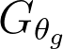
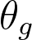
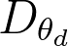
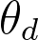
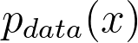
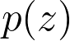
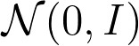
GAN: Minimax Objective Function
: Generator with a set of parameter
: Discriminator with a set of parameter
: real data sample from
: random vector sampled from such as

Slide 7
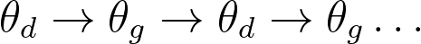
GAN: Minimax Objective Function
HOW do we update ?

Slide 8
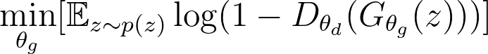
GAN: Minimax Objective Function
HOW do we update ?
Gradient ascent on for
Gradient descent on for

Slide 9
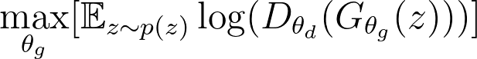
GAN: Minimax Objective Function
HOW do we update ?
Gradient ascent on for
Gradient descent on for
But we will use , Why?

Slide 10
GAN: Minimax Objective Function
HOW do we update ?
Gradient ascent on for
Gradient descent on for
But we will use , Why?
In this case, log(1 − D(G(z))) saturates. Rather than training G to minimize log(1 − D(G(z))) we can train G to maximize log D(G(z)). This objective function results in the same fixed point of the dynamics of G and D but provides much stronger gradients early in learning.
(Generative Adversarial Network, https://arxiv.org/abs/1406.2661)

Slide 11
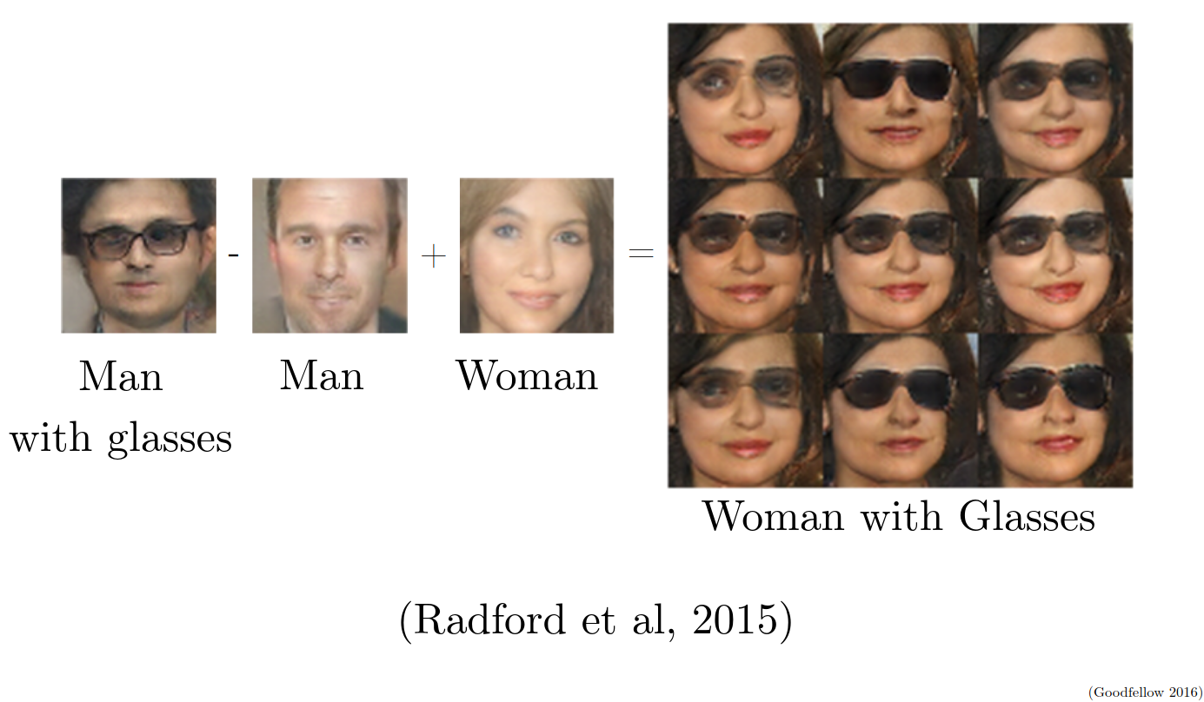
GAN: After training, what does “random sample” z stands for?
Random Vector Input
Generator
Generated Sample
Can be recognized as a latent space of data
Image from https://www.iangoodfellow.com/slides/2016-12-04-NIPS.pdf

Slide 12
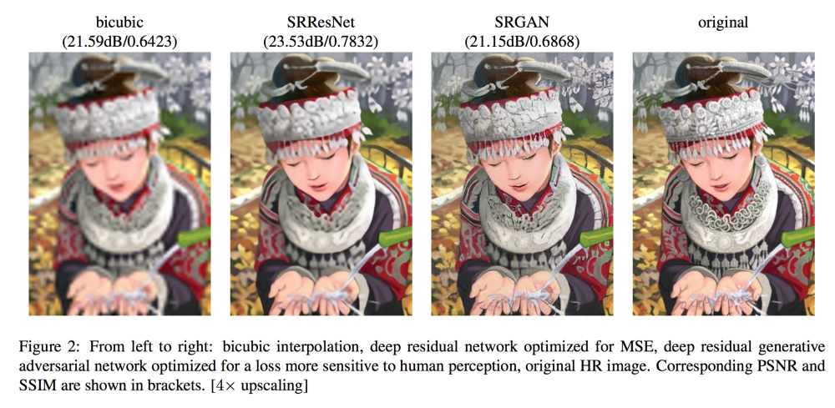
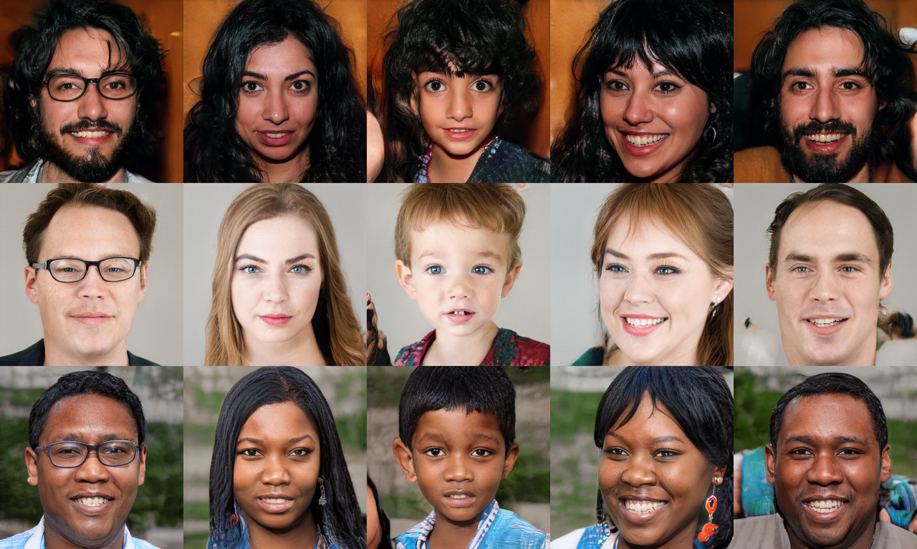
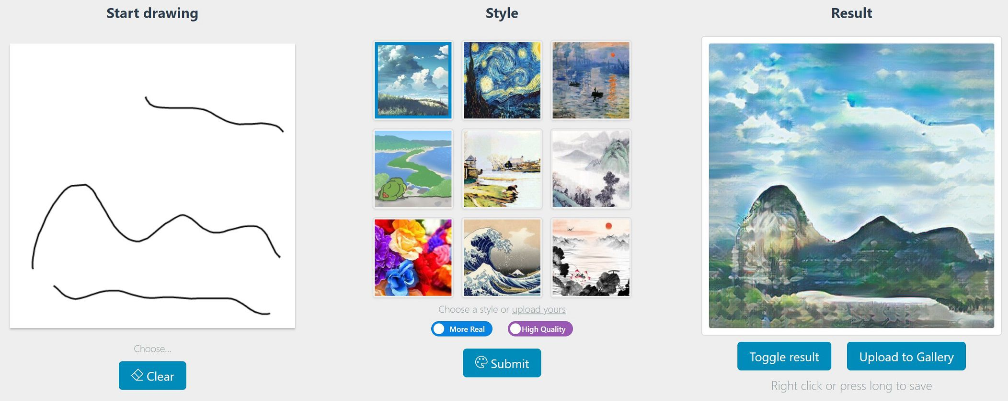
Applications
https://github.com/tensorlayer/srgan
https://github.com/NVlabs/stylegan
https://github.com/mtobeiyf/sketch-to-art

Slide 13
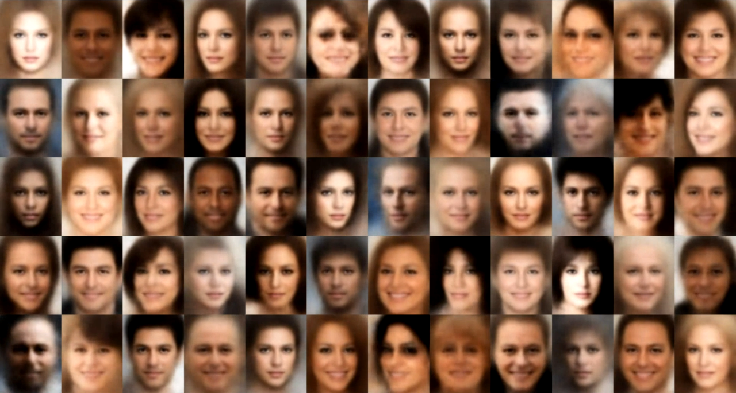
Variational Autoencoder (VAE)? Autoencoder?
One of generative models based on the neural network.
Left is the face generation results based on the VAE.
But what is the autoencoder?
Image source : https://github.com/wojciechmo/vae

Slide 14
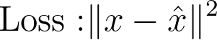
Autoencoder
Learn a latent feature representation of given input.
Trained with data without a label.
Capture meaningful information into the lower dimensional feature vector
Encoder
Decoder
Latent Feature
(lower dimension)
Input
Reconstructed
Input
Notes:
Lower dimension of the latent feature enables the network to capture meaningful information even there

Slide 15
Autoencoder
After training, we can eliminate the decoder, and only use encoder to extract the feature from the input data.
Encoder
Latent Feature
(lower dimension)
Input
Notes:
Lower dimension of the latent feature enables the network to capture meaningful information even there

Slide 16
Autoencoder
We can also try to map the learned latent feature some label you want to predict. (supervised learning)
But...can we use this for data generation?
We do not know how the latent feature is structured!
Encoder
Latent Feature
(lower dimension)
Some label you want to predict in a supervised way
Input
Notes:
Lower dimension of the latent feature enables the network to capture meaningful information even there

Slide 17
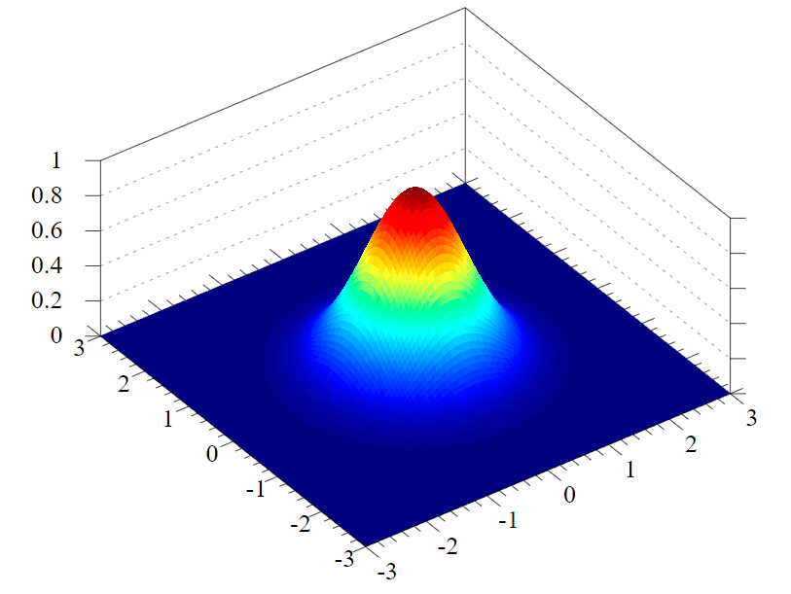
Variational Autoencoder
If there is a true prior distribution of latent feature
Usually is used
We can…
Sample out one latent feature from that distribution
Map that latent feature to sample-data
But how do we train this model?
Decoder
Latent Feature
(lower dimension)
Sampled Data
Latent Distribution
Notes:
Lower dimension of the latent feature enables the network to capture meaningful information even there

Slide 18
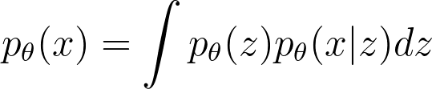
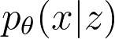
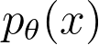
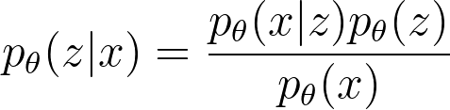
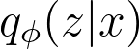
Variational Autoencoder : Training
Let denotes model’s parameter
Can we train to maximize the likelihood of training data?
→ we cannot get this for every latent feature (intractable)
If is intractable, then also :
→ Can we approximate this posterior with ?
Decoder
Notes:
Lower dimension of the latent feature enables the network to capture meaningful information even there

Slide 19
Variational Autoencoder : Training
Notes:
Lower dimension of the latent feature enables the network to capture meaningful information even there

Slide 20
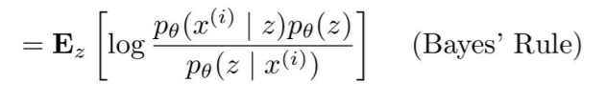
Variational Autoencoder : Training
Notes:
Lower dimension of the latent feature enables the network to capture meaningful information even there

Slide 21
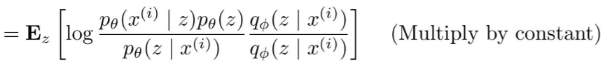
Variational Autoencoder : Training
Notes:
Lower dimension of the latent feature enables the network to capture meaningful information even there

Slide 22
Variational Autoencoder : Training
Notes:
Lower dimension of the latent feature enables the network to capture meaningful information even there

Slide 23
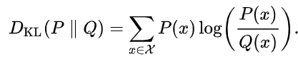
Variational Autoencoder : Training
Remember the KL divergence :
Notes:
Lower dimension of the latent feature enables the network to capture meaningful information even there

Slide 24
Variational Autoencoder : Training
Remember the KL divergence :
Notes:
Lower dimension of the latent feature enables the network to capture meaningful information even there

Slide 25
Variational Autoencoder : Training
Remember the KL divergence :
→ Estimate this with
sampling tricks
→ If posterior is approximated
with Gaussian, this can
have a closed-form solution
→ Still intractable, but since this is
still “KL divergence”,
it is larger than zero.
Notes:
Lower dimension of the latent feature enables the network to capture meaningful information even there

Slide 26
Variational Autoencoder : Training
Remember the KL divergence :
→ Estimate this with
sampling tricks
→ If posterior is approximated
with Gaussian, this can
have a closed-form solution
→ Still intractable, but since this is
still “KL divergence”,
it is larger than zero.
Notes:
Lower dimension of the latent feature enables the network to capture meaningful information even there

Slide 27
Variational Autoencoder : Training
Now let’s try to maximize this tractable lower bound
Use encoder to get the approximated posterior distribution
Get Analytic solution for KL divergence
Maximize likelihood of original input being reconstructed.
Encoder
Decoder
Latent Feature
(lower dimension)
Input
Reconstructed
Input
Latent Distribution
Notes:
Lower dimension of the latent feature enables the network to capture meaningful information even there

Slide 28
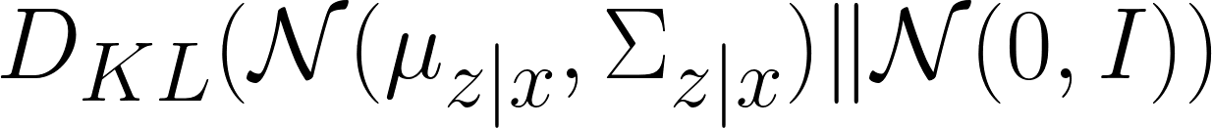
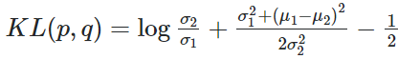
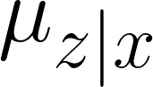
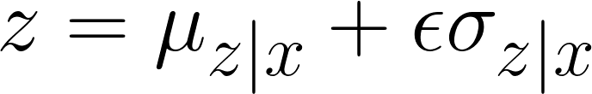
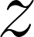
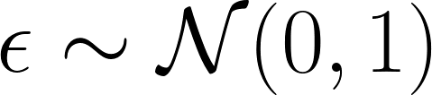
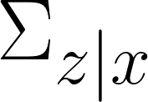
Variational Autoencoder : Training
Enc
Dec
Input
Reconstructed
Input
Notes:
Lower dimension of the latent feature enables the network to capture meaningful information even there

Slide 29
Variational Autoencoder : Testing
Sample out
Dec
True Latent Distribution
Notes:
Lower dimension of the latent feature enables the network to capture meaningful information even there

Slide 30
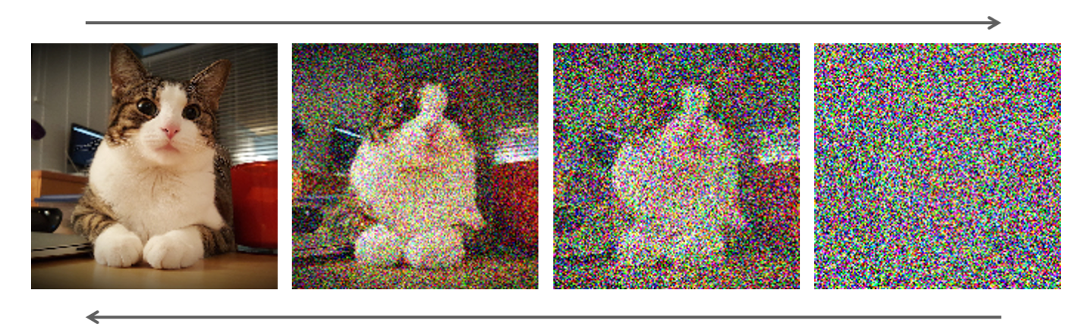
Diffusion Model
Try to check: https://lilianweng.github.io/posts/2021-07-11-diffusion-models/
Diffusion Time step
Learn how to gradually denoise the given noised data, so that input noise can be gradually converted to something look like a sample from data distribution.

Slide 31
Any Questions?

